Slide 1
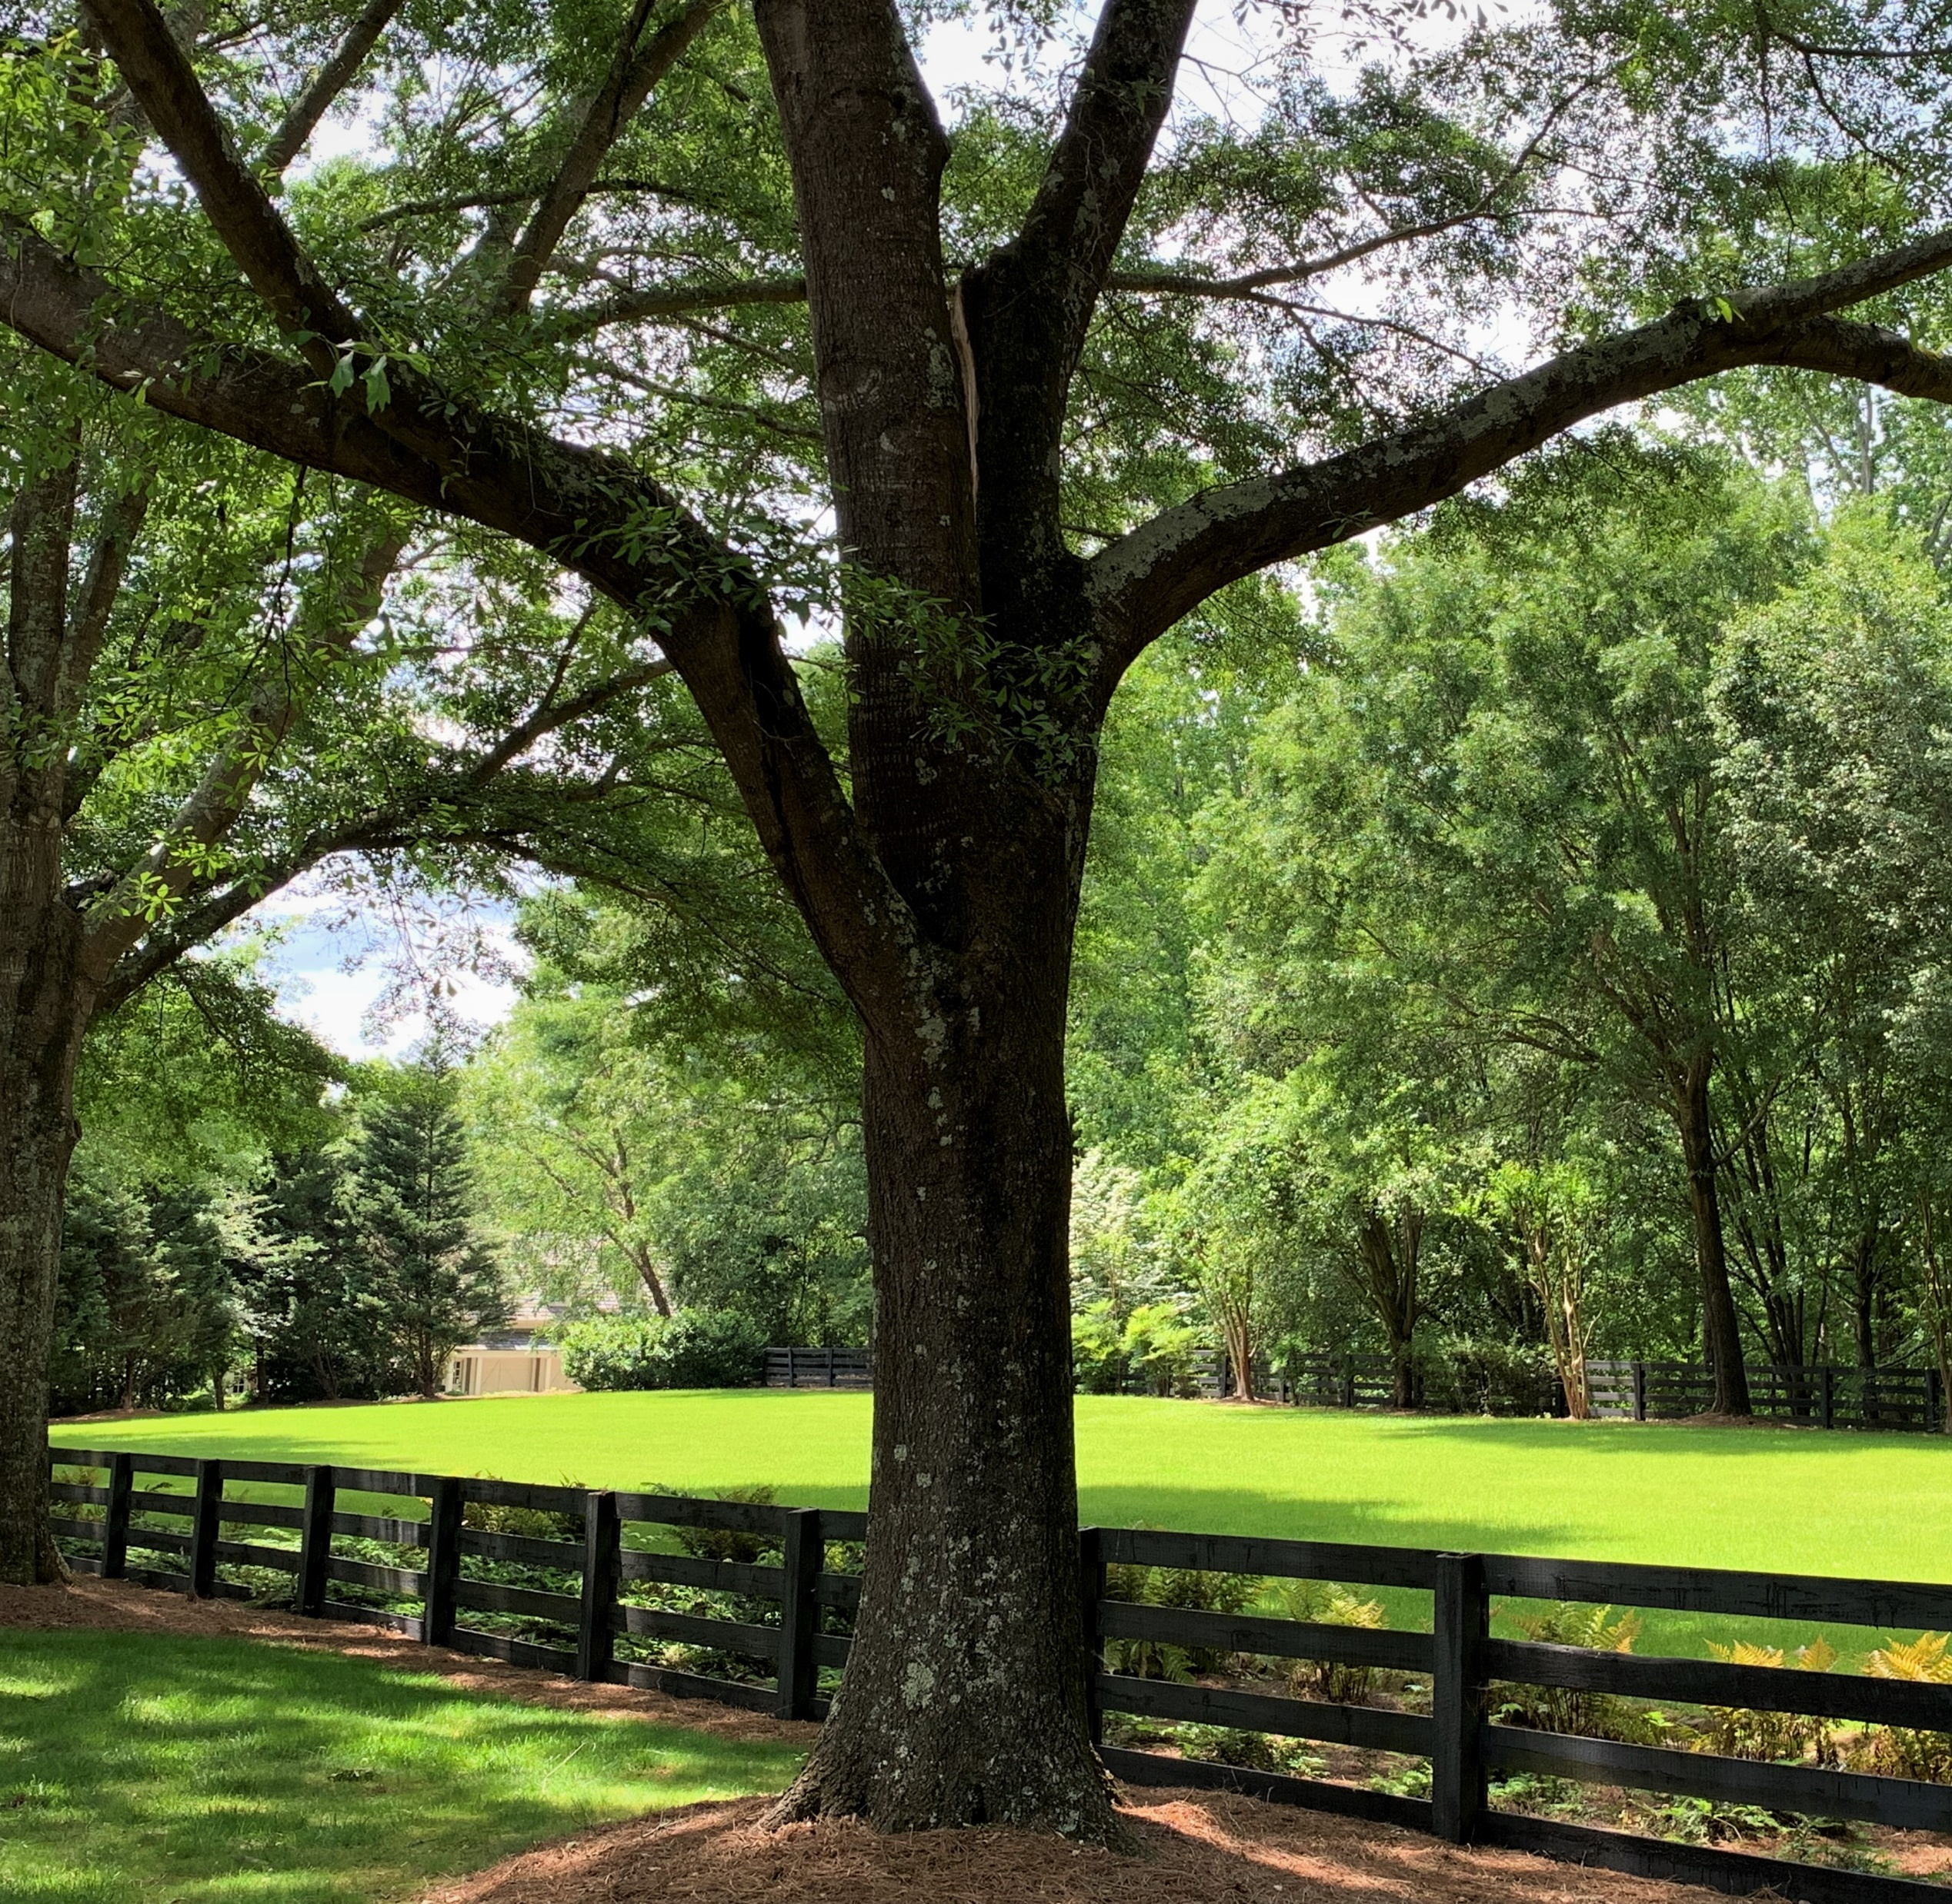
Tree Canopy Conservation Ordinance
Developers Workshop

Slide 2
AGENDA
WELCOME
BRIEF HISTORY OF THE MILTON TREE ORDINANCE
WHAT’S NEW
TREE CANOPY PLAN
TREE CANOPY COVER REQUIREMENTS
SPECIMEN AND HERITAGE TREES
STRUCTURAL ROOT PLATE
REQUIRED TREE LOCATIONS
QUESTIONS
ADJOURN

Slide 3
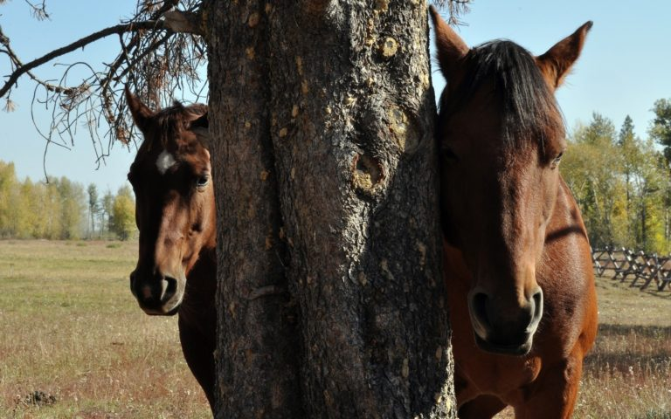
A BRIEF HISTORY
When the City of Milton first incorporated in 2006, they had a Tree Conservation Ordinance based on tree density.
The Tree Canopy Conservation Ordinance was adopted in April 2018 to update to a canopy-based ordinance with the help of a consultant.
For the past couple of years, the City of Milton has worked on amending the Tree Canopy Conservation Ordinance utilizing a Stakeholder Committee, the Planning Commission, and City Staff.

Slide 4
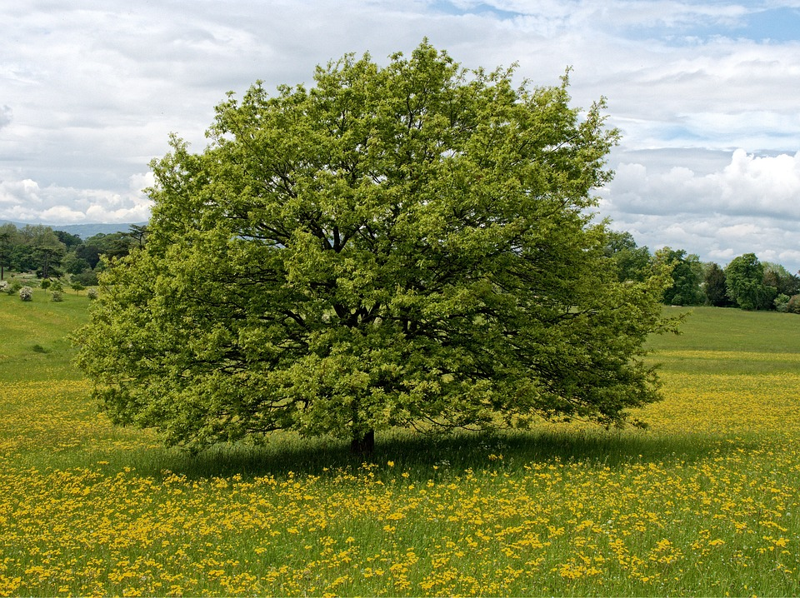
What’s New
Language clean-up to streamline ordinance for clarity
Protected tree size changed from 6” DBH to 15” DBH
Tree canopy coverage minimum requirements
Specimen Tree size and replacement requirements
Structural Root Plate

Slide 5
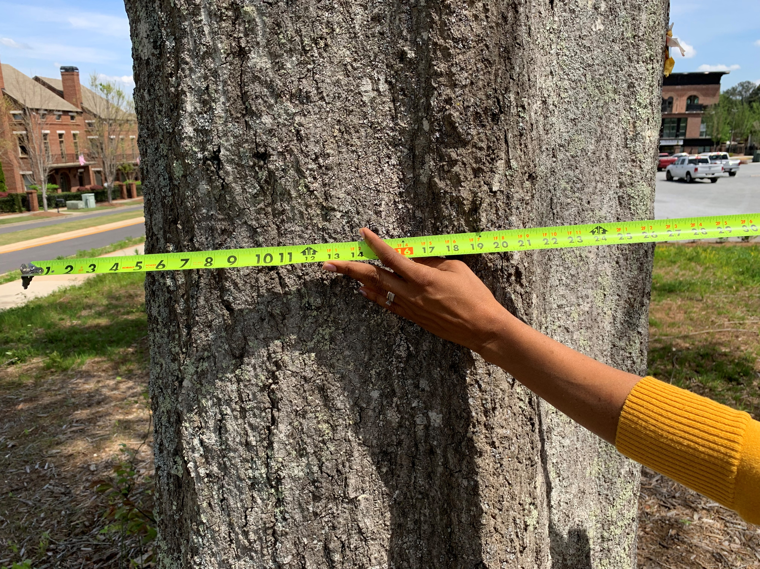
Tree Canopy Plan
Serves as tree removal permit
Shall be prepared by a licensed professional, such as, a certified arborist , registered forester, registered landscape architect, professional engineer, or registered land surveyor
Drawn to scale
Include a tree survey, tree protection plan, and tree planting plan

Slide 6
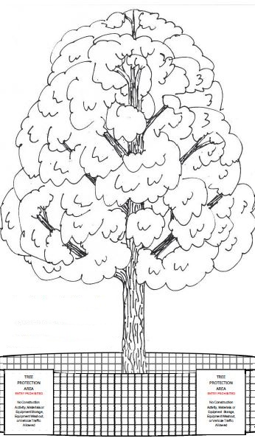
Tree Canopy Plan
Table summarizing tree canopy coverage
Location, DBH, and species of individual Protected Trees. Location of tree groups/forests with description of species and average DBH
Critical Root Zone and Structural Root Plate of Protected Trees conserved
All Protected Trees proposed to be removed
Tree save areas with details
Location of all existing and proposed improvements and access
Proposed grading and limits of disturbance

Slide 7
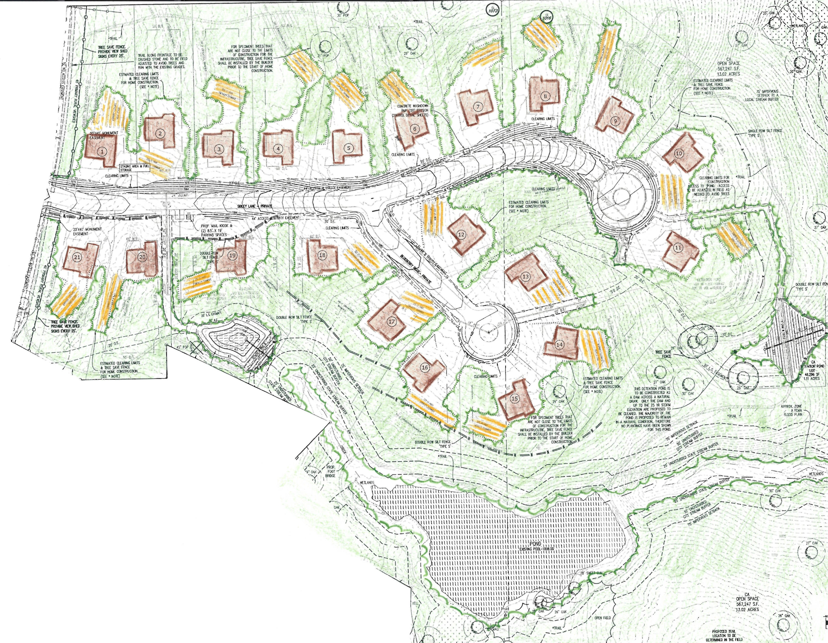
Canopy Coverage Requirements
Currently existing or minimum set forth in Table 1, whichever is less
Shall be met with existing trees to remain or combination of existing trees and planted trees
Existing trees must make up one-third of required canopy coverage

Slide 8
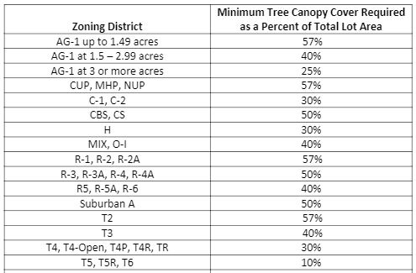
Canopy Coverage Requirements
Table 1

Slide 9
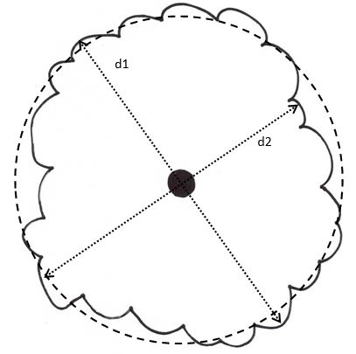
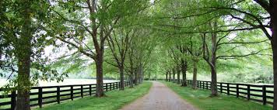
Canopy Coverage Requirements
Actual (Measured) Canopy Cover
Measure widest crown diameter (d1)
Measure perpendicular diameter (d2)
Add both diameters and divide by 2 (D)
Divide average diameter (D) by 2 (r)
Area = 3.14 * r²
Standard Tree Canopy Cover
Tree Canopy Calculation Methods

Slide 10
Canopy Coverage Requirements
Calculating Tree Canopy Cover Percent
Total square foot area covered by tree canopy
Add the tree canopy cover of trees to be planted
Divide by total area of the lot
Multiply by 100
Tree Canopy Calculation

Slide 11
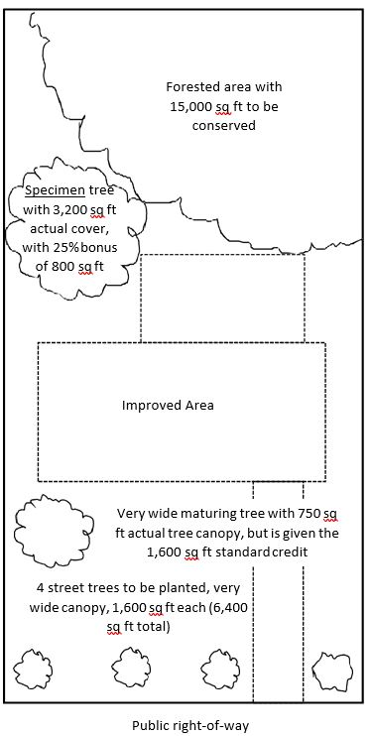
Canopy Coverage Requirements
Example:
AG-1, 1 Acre (43,560 SF)
Tree canopy: 15,000 + 3,200 + 800 + 1,600 + 6,400 = 27,000 SF
27,000 SF ÷ 43,560 X 100 = 62%

Slide 12
Specimen and Heritage Trees
Specimen Tree
Any healthy tree which meets the following size criteria:
24” DBH or greater for hardwoods in the large or medium height class;
27” DBH or greater for Pine species, Sweetgums, and Tulip-Poplar;
8” DBH or greater for trees in the small canopy height class
Heritage Tree
A healthy tree documented as a state/county champion, greater than 75 years old, part of community heritage, Landmark or Historic Tree, or documented historical significance.

Slide 13
Specimen and Heritage Trees
Specimen Tree
Conserved = 25% canopy cover credit
Removed = 150% replacement canopy
Heritage Tree
Conserved = 40% canopy cover credit
Removed = 200% replacement canopy
+ payment into Tree Canopy Fund
($31.25 per 100 SF of tree canopy)

Slide 14
Structural Root Plate
The ground and soil area to a depth of 30 inches with a radius extending out from the trunk 0.5 feet for every inch of diameter at breast height
Any tree with encroachment into the Structural Root Plate will not count as a conserved tree and is not eligible for tree canopy cover credit

Slide 15
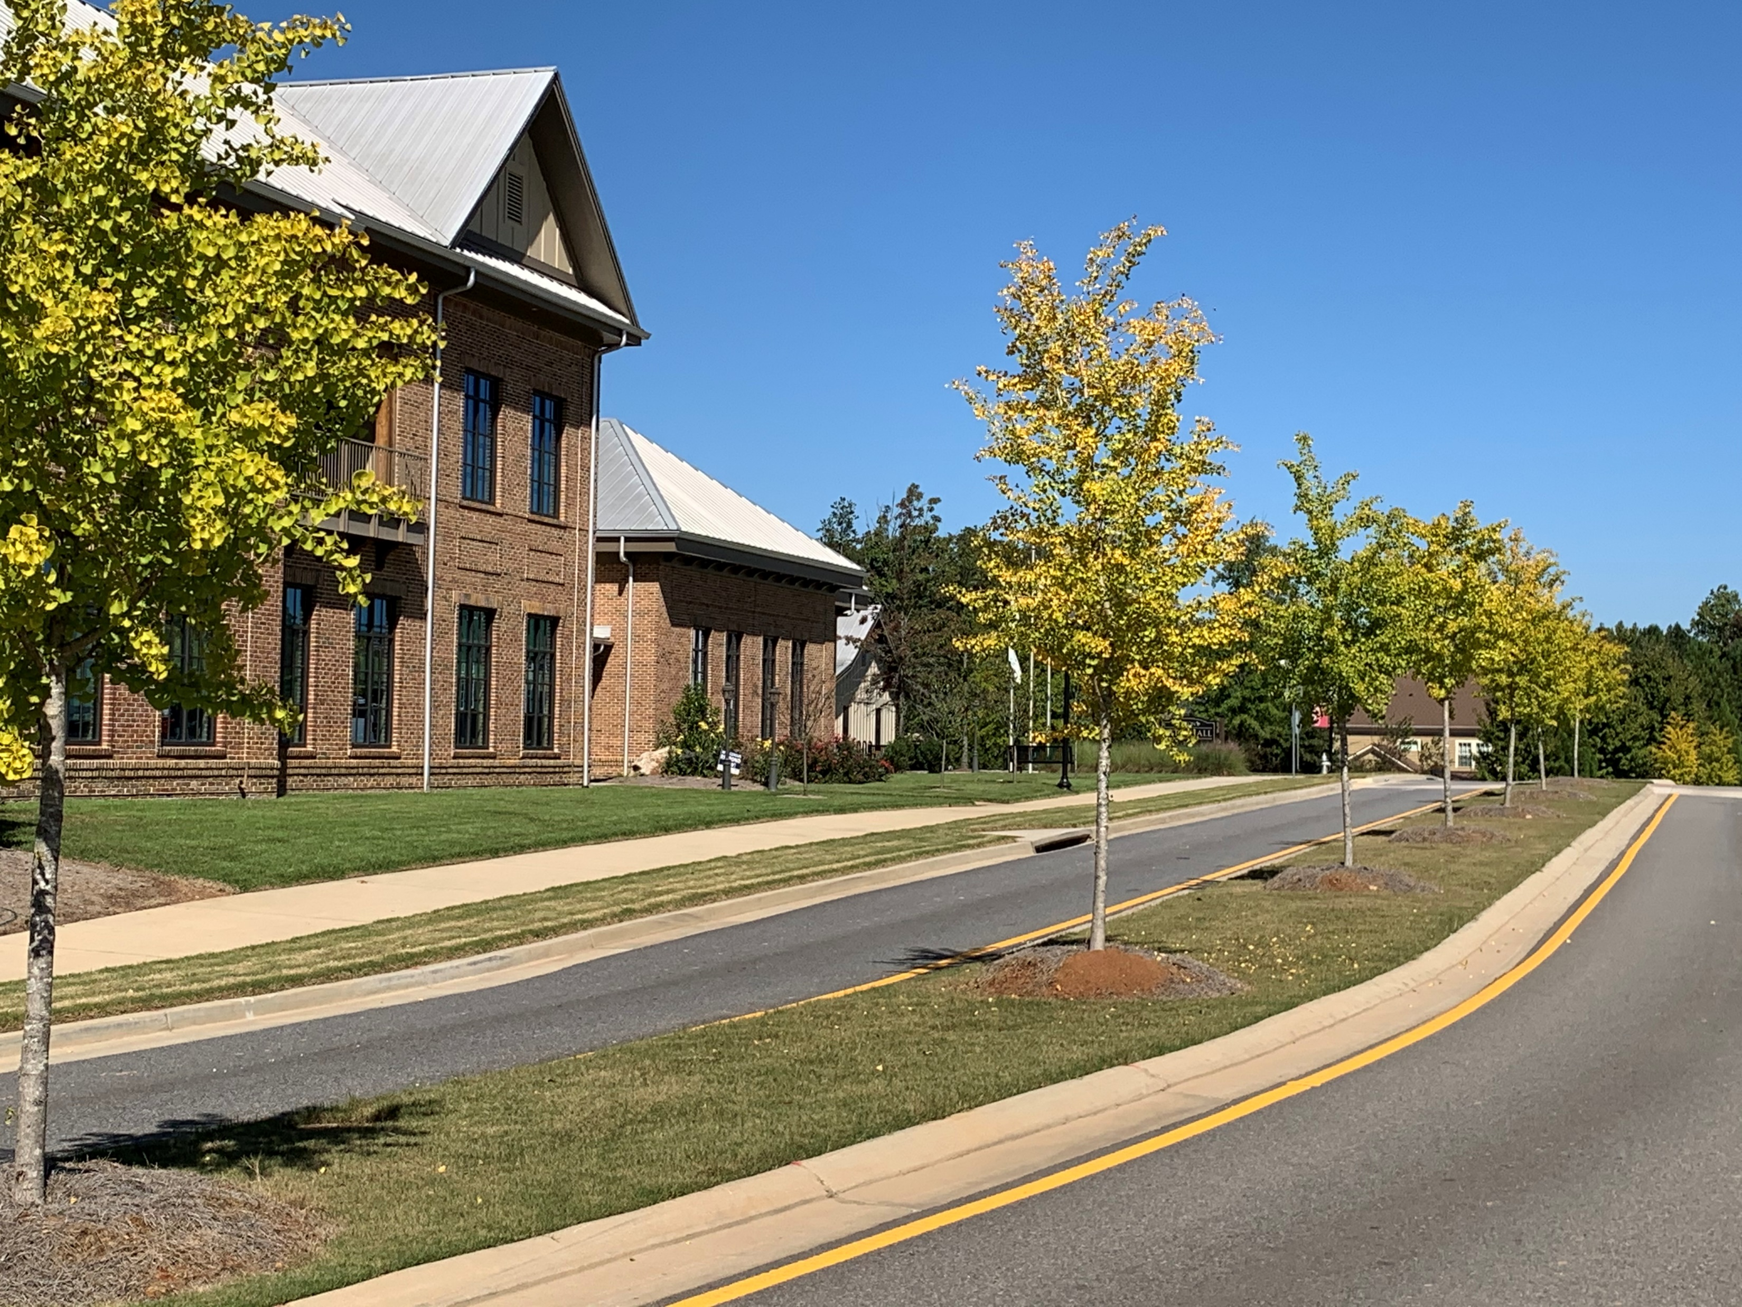
Required Tree Locations
Rural Viewsheds
Required per zoning regulations for major subdivisions
For minor subdivisions and individual undeveloped residential lots, trees conserved within first 60’ of road frontage from an exterior street may receive a 20% additional square feet of canopy cover bonus
Road Frontages
Street trees required in all new developments
May be met with conserved or planted trees
Follow spacing guidelines in Tree Conservation Manual

Slide 16
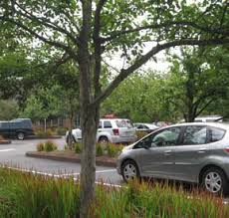
Required Tree Locations
Parking Lots
Conform with Zoning Ordinance requirements
Minimum 1 very wide or wide canopy tree for every sixth space
Landscape Strips
Shall be required as set forth in Zoning Ordinance
Follow spacing guidelines in Tree Conservation Manual

Slide 17
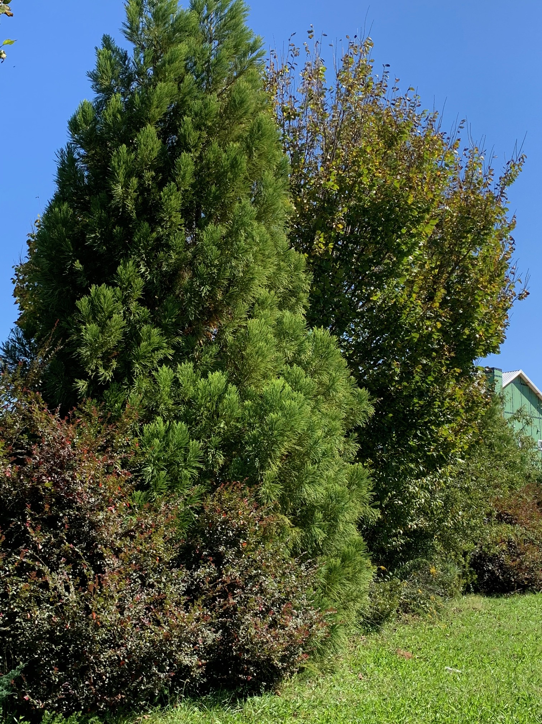
Required Tree Locations
Buffers
Required pursuant to the Zoning Ordinance
Provide visual and noise barrier
Remain undisturbed
Planted where sparsely vegetated with primarily evergreen species
Minimum number of rows determined by buffer width

Slide 18
Questions
Sandra DeWitt, City Arborist
Email: sandra.dewitt@cityofmiltonga.us
Phone: 678-242-2552

